Slide 1
Deal with Stage Fright
Shijie Zhang

Slide 2

Why do people have stage fright
Don’t like people looking at me
Worry forgetting something important
Worry sound boring
。。。
Notes:
How many of you have these little voices inside you when you go on stage?

Slide 3
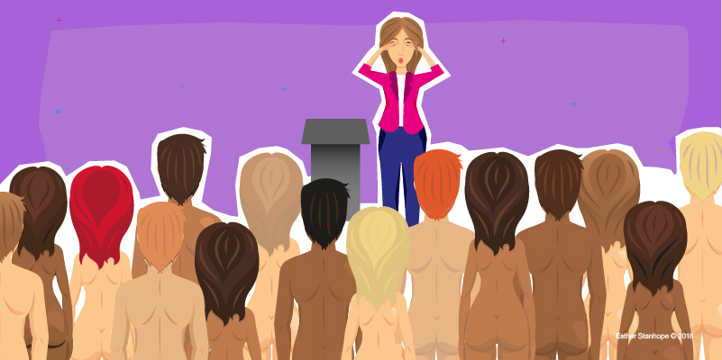
What doesn’t work
Just imagine the audience are naked or in underwear
Notes:
First of all, here is what doesn’t work. The typical advice, people typically tell you that, you want to picture your audience like they are naked or in underwear.
How many of you have heard that? All right, okay. Depending on who you are speaking to, it could be either too exciting or too terrifying. Both are not good, okay? No, don’t picture your audience in underwear or naked, it is not good.

Slide 4
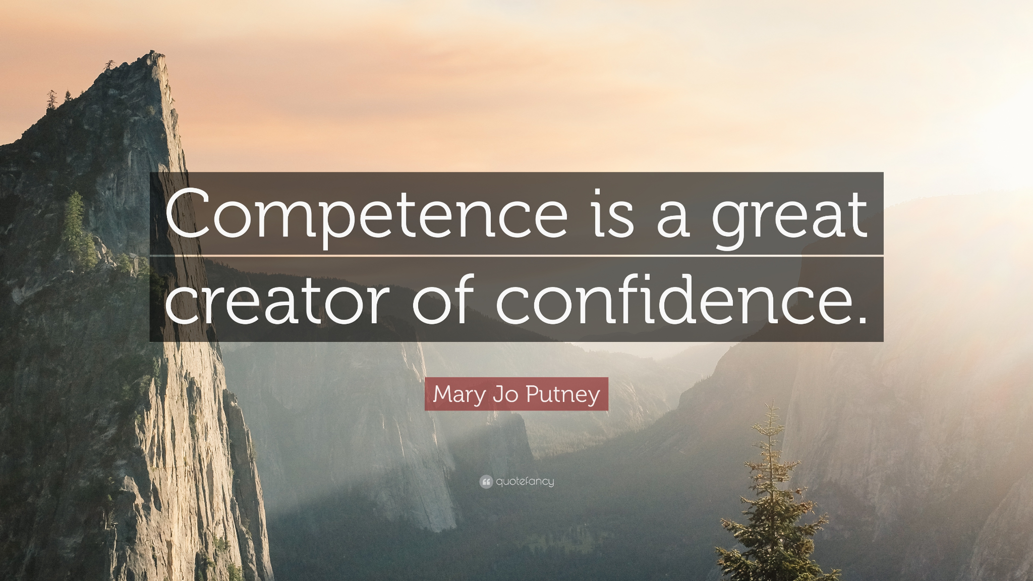
What everyone already knows
Practice until you are sick or tired of it.
Notes:
Most of the people who have stage fright, usually because they are afraid that they’re going to deliver a boring speech. They are afraid that they are not doing a good job. That’s usually an indicator that you have not practiced enough. Because if you have practiced, because repeat after me, confidence comes from competence. If you are good with what you do, if you have skills, you know what, you are not nervous, you are just doing your thing. Practice until you are sick of it. You know what, I could do this in my sleep.

Slide 5
Two quick mental fixes
Focus on your audience, not yourself
Build your power ritual
Notes:
Let me give you two quick mental fixes that really resonate with me. How many? Two. Nowadays when I go up to the stage, I don’t get nervous anymore. Not one bit. Not like even a little bit, none. And I will share with you why.

Slide 6

Focus on the audience, not yourself
Stop being so “selfish”
Notes:
Number 1, focus on your audience, not yourself.
If you feel anxious, if you feel anxiety, if you are afraid that nobody is going to listen to you, if you are afraid that people will no longer show up. Or you might affend someone. All this stuff is what? It is about you. It is all internal. Yeah, it is about you. Do I look good? Do I sound smart? What are they going to think of me? Do they like me?
It’s all about me, me, me, me, does that make sense? Yeah, stop being so selfish. Don’t be so selfish. Focus on the audience. Think, if your focus is external, here is why I don’t get nervous anymore. because I don’t care if I say everything that was meant to say, I said perfectly. That’s not important for me. Looking good is not important for me.

Slide 7

1. Focus on the audience, not yourself
Giving a talk
is like giving
a gift.
Notes:
Cause I focus on the audience. My focus is external, are you getting value? Are you walking away with value? That is it. I don’t care if you like me or not. I truly don’t care because that’s not my job. My job is to help you learn and grow.
If you like me, that’s nice. You might resonate with me a little bit more, but that’s not what I am here for.
So when that is out of the way, why should I be nervous? All this stuff, all the fear, all the anxiety, it’s me-me-me-me-me. You won’t feel nervous because it doesn’t matter.
That’s why I break all the rules. You know, in public speaking, in toastmasters, you know, don’t put your hands in your pockets, you are not supposed to use profanity, you are not supposed to do this. All these rules, I don’t give a damn about these rules.
My rules are: Am I delivering value? Am I being effective? Am I being an effective communicator? Is my message getting through? If it is, then I will keep doing it. If it doesn’t work, the audience, I will know. Then I stop doing it. Everything else, I do not care. This is all noise.
So don’t focus on yourself, focus on the audience. What’s the objective? Why are you even here? What gives you the right to be on the stage? What are you there to do? If that’s clear, everything else is easy.
Yes?

Slide 8
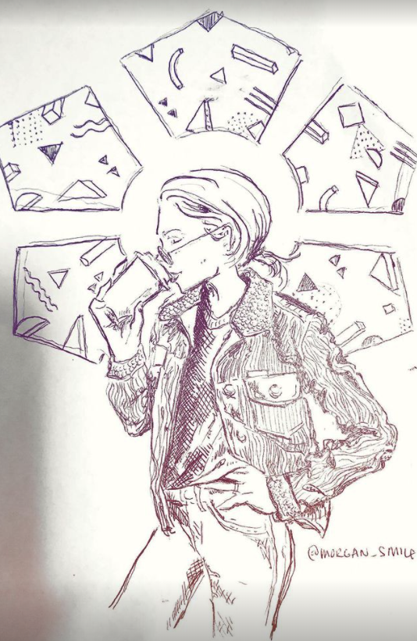
2. Build your power ritual
Change your energy state
Notes:
Before a presentation, give yourself some personal time to go through your power routine. That’s so true for me because in my blood I am more introvert. In my free time, my energy level is more of a thinker, than a speaker.
This does not only apply to my case. Imagine that you waked up and it was just not my day. It’s one of those blue days. Man, so, eh, I am just gonna, go up there. And kinda just do my thing. Say hi to everybody. You don’t want to live it to chance.
We want to build power ritual to change our energy state so that we could shift our energy state anytime to be ready for the speech. Next I will share with you my power ritual before I go to a speech.
That’s exactly what we want before a speech, just like Shuu, we are already in the state. So here is the power ritual that resonates with me.
Let me share with you a personal example, on the right side it’s my yoga coach and she is also good at drawing. One thing really impressed me is her capability to change her energy state and shift to a different activity. For example, when she was enjoying her morning, she would start drawing on the back of the receipt. And about 10 minutes later when she finished her coffee, she already finished a small drawing on the back of receipt. And she will usually give that drawing to the cashier or leave on the table as a gift. It is truly amazing. I really like writing, but each time I need to think about several days before I could start writing. Drawing is a similar activity and she could just do it like so easily. The secret she shared with me is that we want to build our power ritual. In her case, she would always get a coffee, grab the same type of paper and pencil, follow the exact same process during drawing. That’s how she could shift her state so quickly.

Slide 9
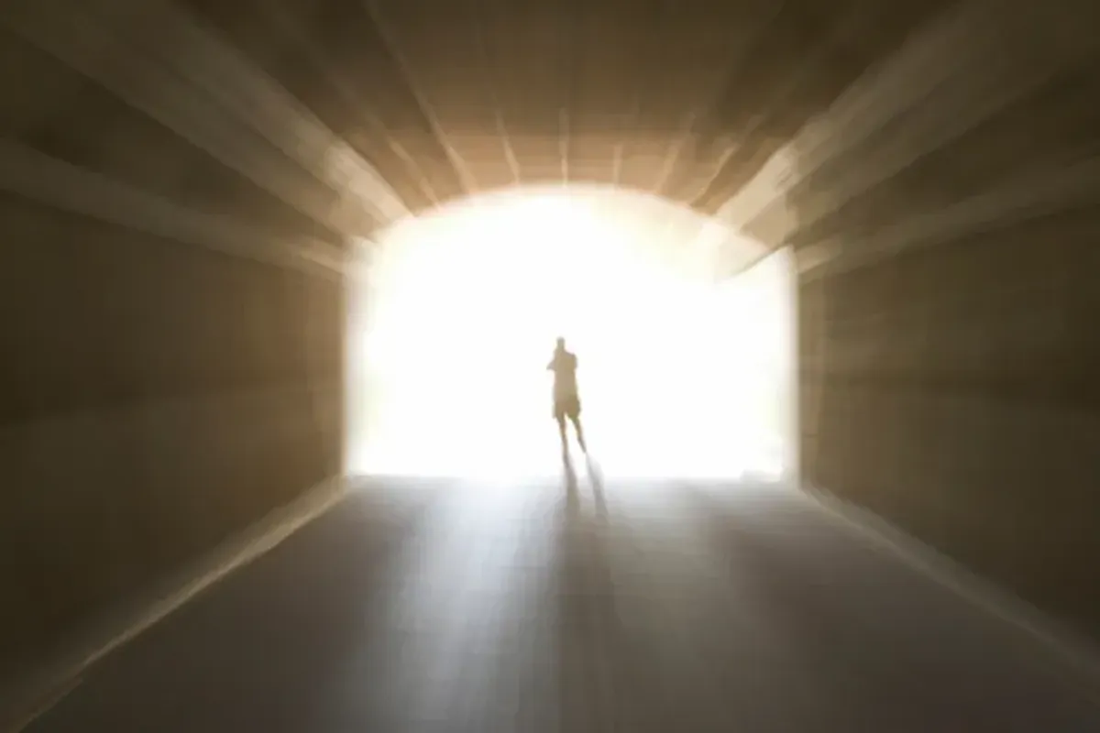
2. Build your power ritual
Visualization
Notes:
First, in order to not focus on myself, to focus on the audience, We want do a very quick visualization exercise. And here is what I visualize: I will close my eyes and I will do it like that. And I will visualize a big bright white light, beaming from the skype, to me, through here, through my forehead, my hair and through my whole body. So I become a big, bright, white light. From there, then I visualize this bright light, and it will get brighter and brighter, and it will “shuuhhh”, fill the whole room. That’s what I visualize, it will fill the whole room. And in my mind, my intention is I am going to make sure everyone who comes to my presentation, every single person is going to walk away with some kind of value. Even though they would not agree with my message, even though they might not like me so much. You see, how that shift all focus off me.
Once I have done that, now you can see, I don’t know if you can see it. After a few seconds of that, do you see a difference in my eyes? I don’t know if you can see it, I could sense it, okay? Light up, after that, I am in a different state.

Slide 10
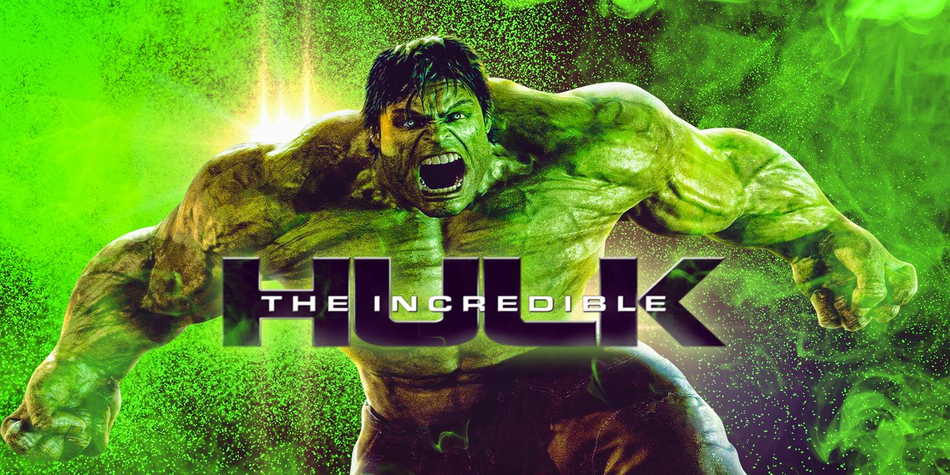
2. Build your power ritual
Power move
Notes:
Now, I need to get my energy up. Get my what? Energy up. Cause I want you guys to be excited. If I am a five, you guys will be a two. So how do I get up to a ten? So usually I will be jumping, jumping up and down, my martial background, a little kickboxing, then I will deep breath, and then I will just wait. Usually I will also open my arms, because I want to be just relaxed, opened, don’t want to be like that. Want to be open. And I will just wait. And then whoever is introducing me. Now he is talking, and I am jumping. I am going, I am going. And then what I do is that I will make the switch.
How I make the switch is I have my own power move, you got to develop your own power move, whatever it means for you. Here is my power move.
So waiting, waiting, host is doing introduction, I’m there, take a deep breath. When I make the switch, I will go (pat on chest), I am ready.
So, if you can imagine, let’s just do this. Then boom, I am in state. Some of my friends, one of my speaker friends, he does a hulk move. He is like “hoooo”. He does that, and it works for him. He will do it three times, and he will go. Whatever works for you. But you want to have you own power move. Cause you can make the switch any time.
Do my thing, visualize, deep breath, jumping up and down, get in the zone. Now you can see when I do the move, you can see the shift in energy.

Slide 11
Summary
Two quick mental fixes for stage fright
Focus on your audience, not you.
Build your power ritual to make switch anytime.

Slide 12
References
Overcome stage fright: https://m.youtube.com/watch?v=mL88P-O-5CU&t=300s
【可复制的沟通力18】 怎样消除演讲的紧张感: https://m.youtube.com/watch?v=qLbw39QIZY0&t=452s

